Slide 1


CTC FY : 2016-17
Integrated Annual
Operating
Plan….

Slide 2
Bifurcation of revenue projection ( Sakal + other publications.)
Revenue from | 2015 2016 ( Rs. In Lacs) | 2016 2017 ( Rs. In Lacs) | Growth ( IN lacs)
Hard sale | 150.00 | 200.00 | 50.00
Special initiatives | 24.00 | 100.00 | 76.00
Missing clients | 100.00 | 125.00 | 25.00
Deals ( Multi editions ) | 300.00 | 350.00 | 50.00
Notice/Banking/AFR /Obituary etc. | 281.00 | 206.00 | -75
Other Publications | 20.00 | 24.00 | 4.00
Grand Total | 875.00 | 1005.00 | 130
Total projection of Sakal Mumbai is Rs.10.05 CR.
( Projection of FY 2016- 2017)

Slide 3

HARD SALE STARTEGY….
HARD SALE OVERVIEW
Details | FY – 2015-16 | Projection : 2016-17 | Hike in % | Growth
No. of Hard Sale | 300 | 350 | 17% | 50
Revenue Generation | 1.49 crs | 1.78 crs | 20% | 29 Lacs
NEW/SPECIAL INITIATIVES (Special Supplements (Above half page), Features, Booklets
Details | FY – 2015-16 | Projection : 2016-17 | Hike in % | Growth
No. of Special Initiatives | 3 | 8 | 275%
Revenue Generation | 24 lacs | 1.11 crs | 500%

Slide 4
ADVT. SALES TEAM
Special Initiatives
Projected in year
2016 - 2017

Slide 5
Special Initiatives: Print + Tv + Online
Festivals
Ganapati Aras pustika
Health :
Social Connect
Road safety week
Mazhe Karya Mazha vibhag
Wealth
Samriddhi Abhiyan
Diwali Booklet
Yanda Kartaya Ahe
Thane Mahotsav
Arogya Sampada
Reader
Connect
Initiative

Slide 6
Special Initiatives : Key Features
Arogya Sampada
Comprehensive health camps
Each Camp to focus on specific needs viz women hygiene etc
26 camps across 26 location in Thane/Raigad/Navimumbai with support from print/Tv

Slide 7
Special Initiatives : Key Features
Sakal Samriddhi Abhiyan
Investor education initiative in ass with Birla MF
10 events in 10 cities .
Pre & Post event publicity through print/Saam Tv

Slide 8

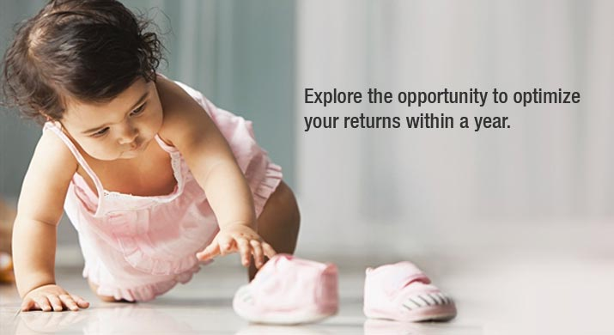
Sakal Samruddhi Bachat Abhiyan ( Birla Mutual fund)
April to March 2016 – 2017
There will be the Investment guidelines events all over the mumbai, Nasik & Pune
Projected Revenue: Rs. 50 L

Slide 9
Special Initiatives : Key Features
Traffic Kiosk
50 key junctions to have branded traffic islands ( kiosk)
Each kiosk equipped with medical kit , water cooler .
Excellent Branding opportunity for sakal & associate brands

Slide 10
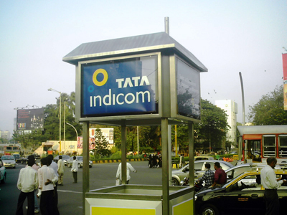
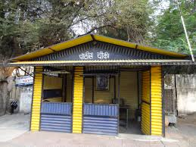


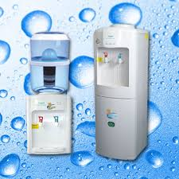
Sakal Salute to Mumbai Police
Since June 2017
Sakal will provided 50 Junctions in Mumbai Sponsored stalls with Solar fans ,water cooler with grand event with the Commissioner of Mumbai. This will be the social event of Sakal.
Projected Revenue: Rs. 50 L

Slide 11


Booklet & Event on Road Safety Week
7th January 2017
We have planned special booklet & event with circulation drive for this event.
Projected Revenue: Rs. 3 L

Slide 12

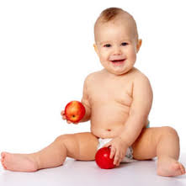
Healthy Baby Competition
15th November 2016
We have plan Healthy baby competition in Thane. We will call 200 kids with 400 parents in AC hall with play games etc.
Projected Revenue: Rs. 5 L

Slide 13



Yanda Kartavya Aahe
5th December 2016
We will have plan a Wedding special GNP supplement with Vadhu Var guidelines event.
4 Pgs. GNP
Projected Revenue: Rs. 5 L

Slide 14


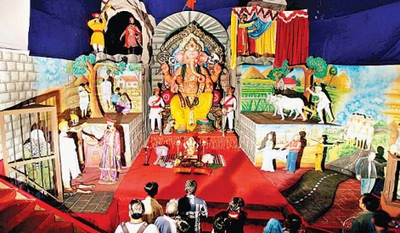
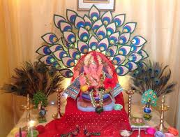
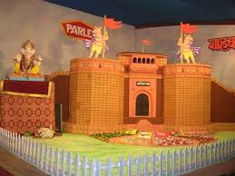
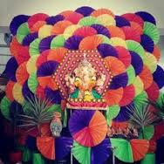
Ganapati Aaras Pustika & Competition
September 2016
We will give the how to decorate the home Ganesh Dekhawa in our Pustika. We can arrange the competition of Gharcha Ganapati Competition
Projected Revenue: Rs. 5 L
GANAPATI AARAS PUSTIKA

Slide 15


Diwali Magazine
October 2016
This willl be the revenue making Magazine with the help of our reporters from Diwali festival.
Projected Revenue: Rs. 20 L

Slide 16
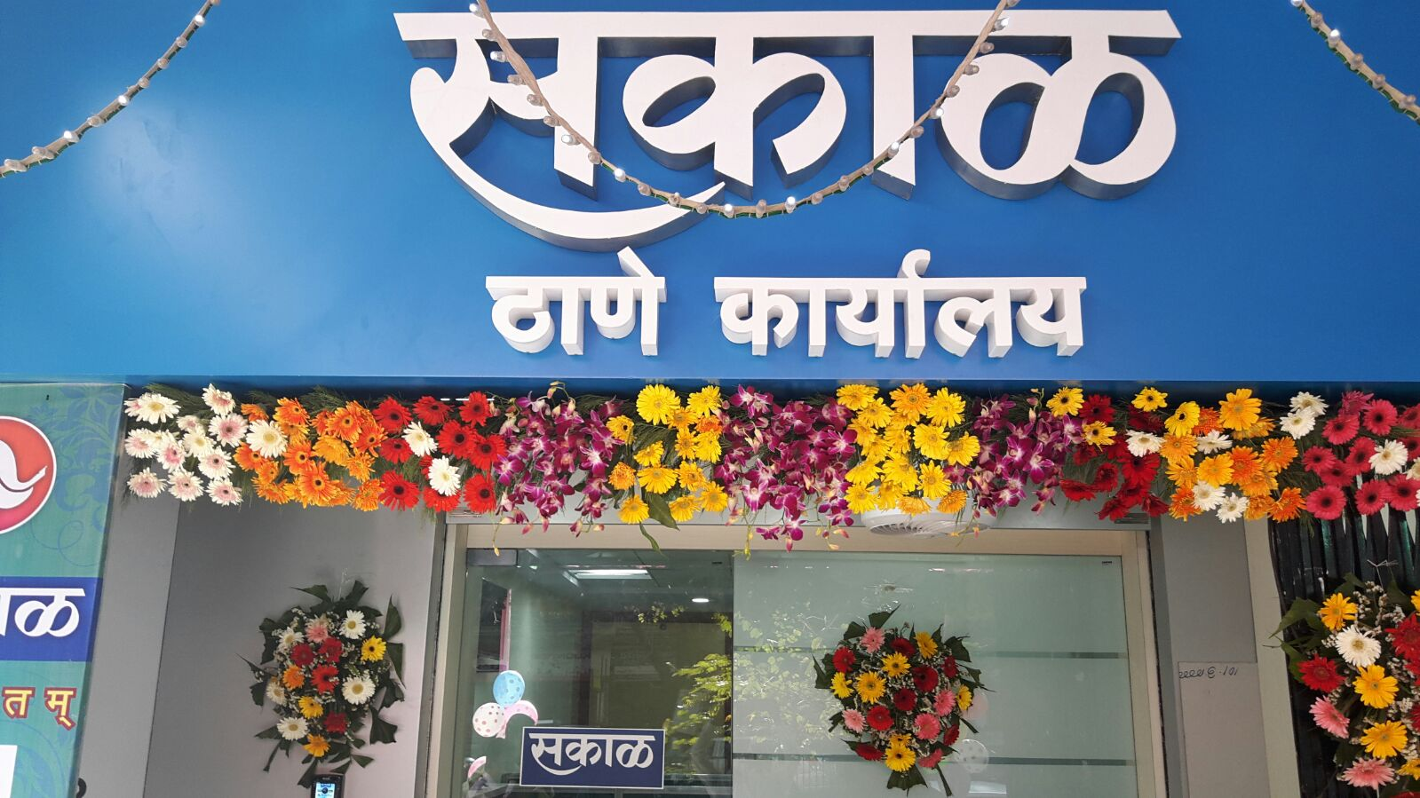
Thane Festival Event & Supplement
5th March 2017
Thane Festival event & supplement
Projected Revenue: Rs. 15 L

Slide 17
Revenue Generated From Missing Clients….
Revenue to be generated from missing clients
Details | FY – 2015-16 | Projection : 2016-17 | Hike in % | Growth
No. of Clients ( Deals) | 11 | 14 | 20% | 20%
Revenue Generation | 25 Lacs | 30 Lacs | 20% | 20%

Slide 18
Thank You

